Slide 1
Android OS
Group 2 Sangey Lama, Tamás Kalapács, Mirjana Erceg, Andreas Richardsen, Zahro-Madalina Khaji

Slide 2
General Overview
Based on Linux OS
Designed for use touch screen mobile devices (smartphones / tablets)
Software stack OS with a variety of frameworks and drivers
Android Runtime & Dalvik Virtual Machine (.dex)
Kernel Modifications (alarms and wakelocks)

Slide 3
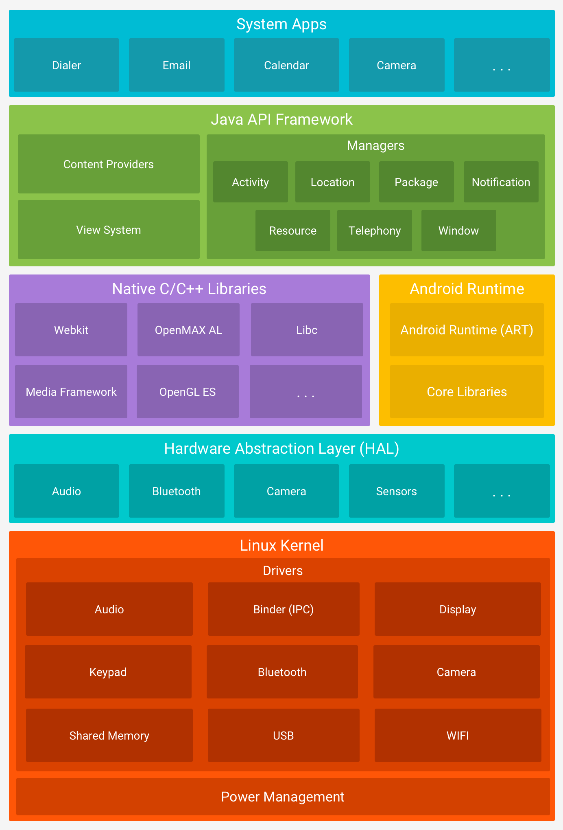
Software Stack
Linux Kernel – memory management and threading
HAL – standard interfaces for use of hardware components e.g. camera Bluetooth
Android Runtime – running of virtual machines and executing .dex files for a lower memory footprint
Native C/C++ lib – needed to run ART and HAL services but can also be useful to app developrs
Java API Framework – Useful building blocks which simplify the reuse of core / modular system components and services.
System apps – core default apps provided by android for common services e.g. email, SMS, internet browsing, etc.

Slide 4
Android Runtime and .dex
DEX – a specifically designed bytecode format optimized to minimize apps memory footprint.
Build toolchains such as Jack, compile Java sources into DEX bytecode
Each app on an android device will run in its own instance of Android Runtime (ART). ART runs multiple virtual machines which execute the DEX bytecode.

Slide 5
Linux Kernel modifications
Similar to standard Linux – however drivers not applicable to mobile environments were removed, meaning a smaller kernel.
Power Management – two big modifications to the kernel include alarms and wakelocks to save battery power.
Alarms – alarm capability implemented in the kernel allows apps to request wake-up services even in sleep mode.
Wakelocks – prevents the system from entering sleep mode, if no wakelock exists the device automatically powers off after sometime.

Slide 6
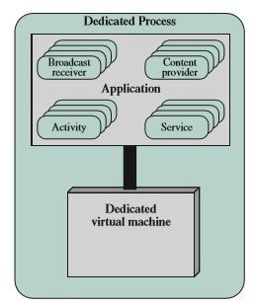
Android Applications
Each android application is built using up to 4 components, each of which perform a distinct role. (Activities, Services, Content Providers, Broadcast services).
Each application runs its personal dedicated virtual machine and a single process which encompasses the components and Virtual machine.

Slide 7
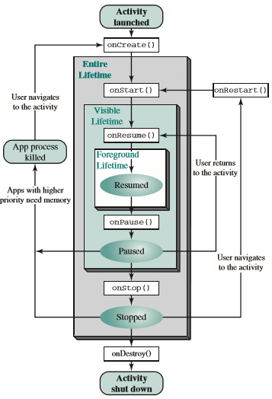
Activity states
The various states for an activity can be during an application’s normal operation.

Slide 8
Threads
When an application is launched, the system creates a thread of execution for the application, called "main” also known as the UI thread.
The system does not create a separate thread for each instance of a component, all are run on the main thread which can lead to problems. e.g. blocking the UI when performing complex operations.

Slide 9
Worker Threads
When the UI thread is blocked, no events can be dispatched, including drawing events. The application will appear to hang/freeze.
If the UI thread hangs for too long (currently >5 secs) the user is prompted with the “Application not responding” ANR dialog. Leading to unhappy users.
Due to this single threaded model, operations that are not instantaneous should be run in separate worker threads.

Slide 10
Memory Management
The Android Runtime use paging and memory-mapping (mmapping) to manage memory.
The only way to release memory from an app is to make the memory available to the garbage collector.

Slide 11
Garbage Collector
Keeps track of each memory allocation. Once it determines that a piece of memory is no longer being used by the program, it frees it back to the heap.
Two goals:
find data objects in a program that cannot be accessed in the future
reclaim the resources used by those objects
Android’s memory heap is a generational one.
It can slow down the apps.

Slide 12
Sharing memory
In order to fit everything it needs in RAM, Android tries to share RAM pages across processes. It can do so in the following ways:
Zygote
Most static data is mmapped into a process
Sharing the same dynamic RAM across processes
To maintain a functional multi-tasking environment, Android sets a hard limit on the heap size for each app.
Android keeps apps that are not foreground in a least-recently used (LRU) cache.

Slide 13
Scheduling
Android’s scheduler is based on the Linux kernel which utilizes real-time and non-real-time scheduling.
It includes 3 classes for scheduling:
SCHED_FIFO: First-in-first-out (real-time threads)
SCHED_RR: Round-Robin (real-time threads)
SCHED_OTHER: Other (Non-real-time threads)
FIFO and RR have higher priorities values (0-99) while OTHER classes range from (100-139)
A lower value results in a higher priority.

Slide 14
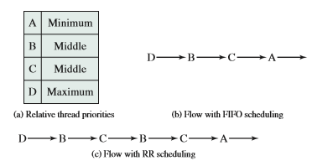
FIFO vs RR
Round-Robin utilizes timeslices for same level priority threads while First-in-first-out will execute until each thread waits or terminates.
In FIFO: D executes until it terminates, B executes next as it is the next highest priority and has been waiting longer than C, Next C executes and finally A can execute.
In RR: D executes firsts, next B and C are timesliced as they have the same priority and finally A can execute.

Slide 15
cgroups
In android several apps may have background threads waiting to execute. This could lead to performance issues for the foreground application.
To avoid this, background threads are moved into a background cgroup.
The cgroup is assigned a small percentage of the CPU, allowing some progress but not enough to affect foreground performance.
This ensures foreground threads will always have priority.

Slide 16
I/O Scheduling
In android there is a large amount of I/O schedulers to choose from.
This is due to various different needs of the schedulers based on the situation e.g.
Hard Disk Drive vs Solid State Drives & flash storage
Speed vs Stability
UI responsiveness
Database Access and queries
etc
Available schedulers: CFQ, deadline, VR, Noop, BFQ, FIOPS, SIO, ROW, ZEN, SIOplus, FIFO, Tripnandroid, Maple.

Slide 17
Best I/O Scheduler
Strictly there is no best scheduler as it will depends on your needs.
Modern smartphones use the Noop Scheduler as it is one of the simplest and stable algorithms and works well with flash drives.
Another commonly used scheduler is Deadline which imposes a deadline on all I/O requests which prevents starvation of requests.

Slide 18
File System
Android uses a single root which is then split into multiple partitions e.g. boot, system, data, cache, misc
Boot – responsible for device booting
System – Contains core parts of the android OS
Data – Contains user data e.g. contacts, installed apps, messages
Cache – for storing frequently access data and app components
Misc – contains miscellaneous system settings for the device.

